Slide 1
EOC Design Considerations and Examples

Slide 2
EOC Design Considerations
A properly-designed EOC should:
Serve as an effective and efficient facility for coordinating emergency response efforts
Serve a number of uses including operations, training, and meetings
Optimize communication and coordination by effective information management and presentation.

Slide 3
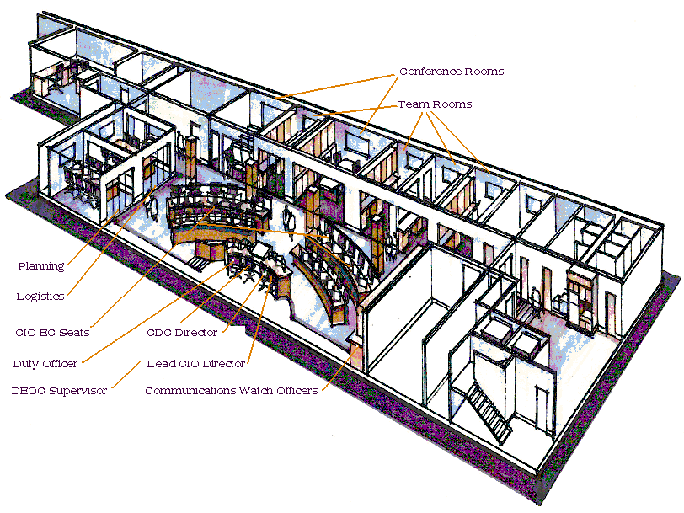
EOC Layout
Communication and eye contact between decision makers
Space for:
Operational
Coordination
Decision Making
Collaboration
Communications

Slide 4
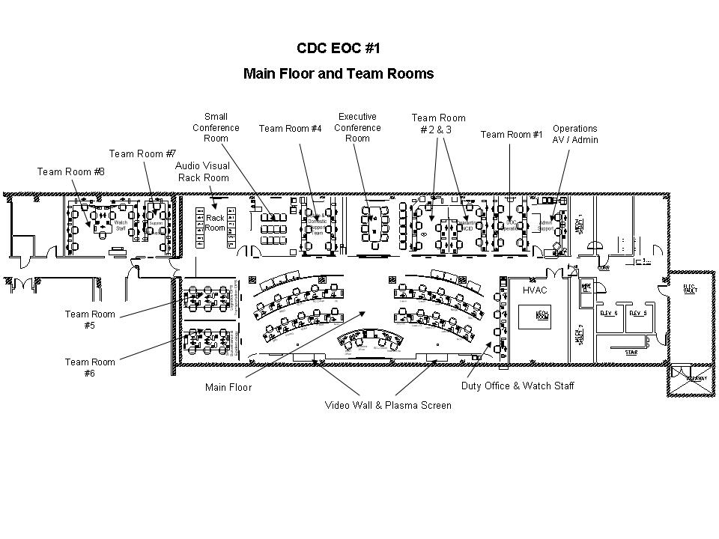
CDC EOC 1

Slide 5
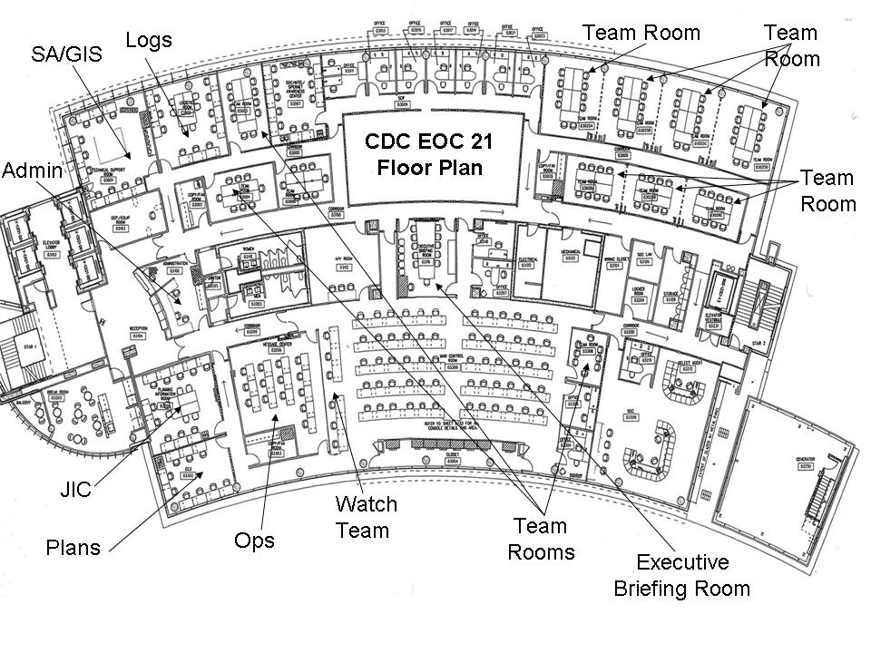
CDC EOC 21

Slide 6
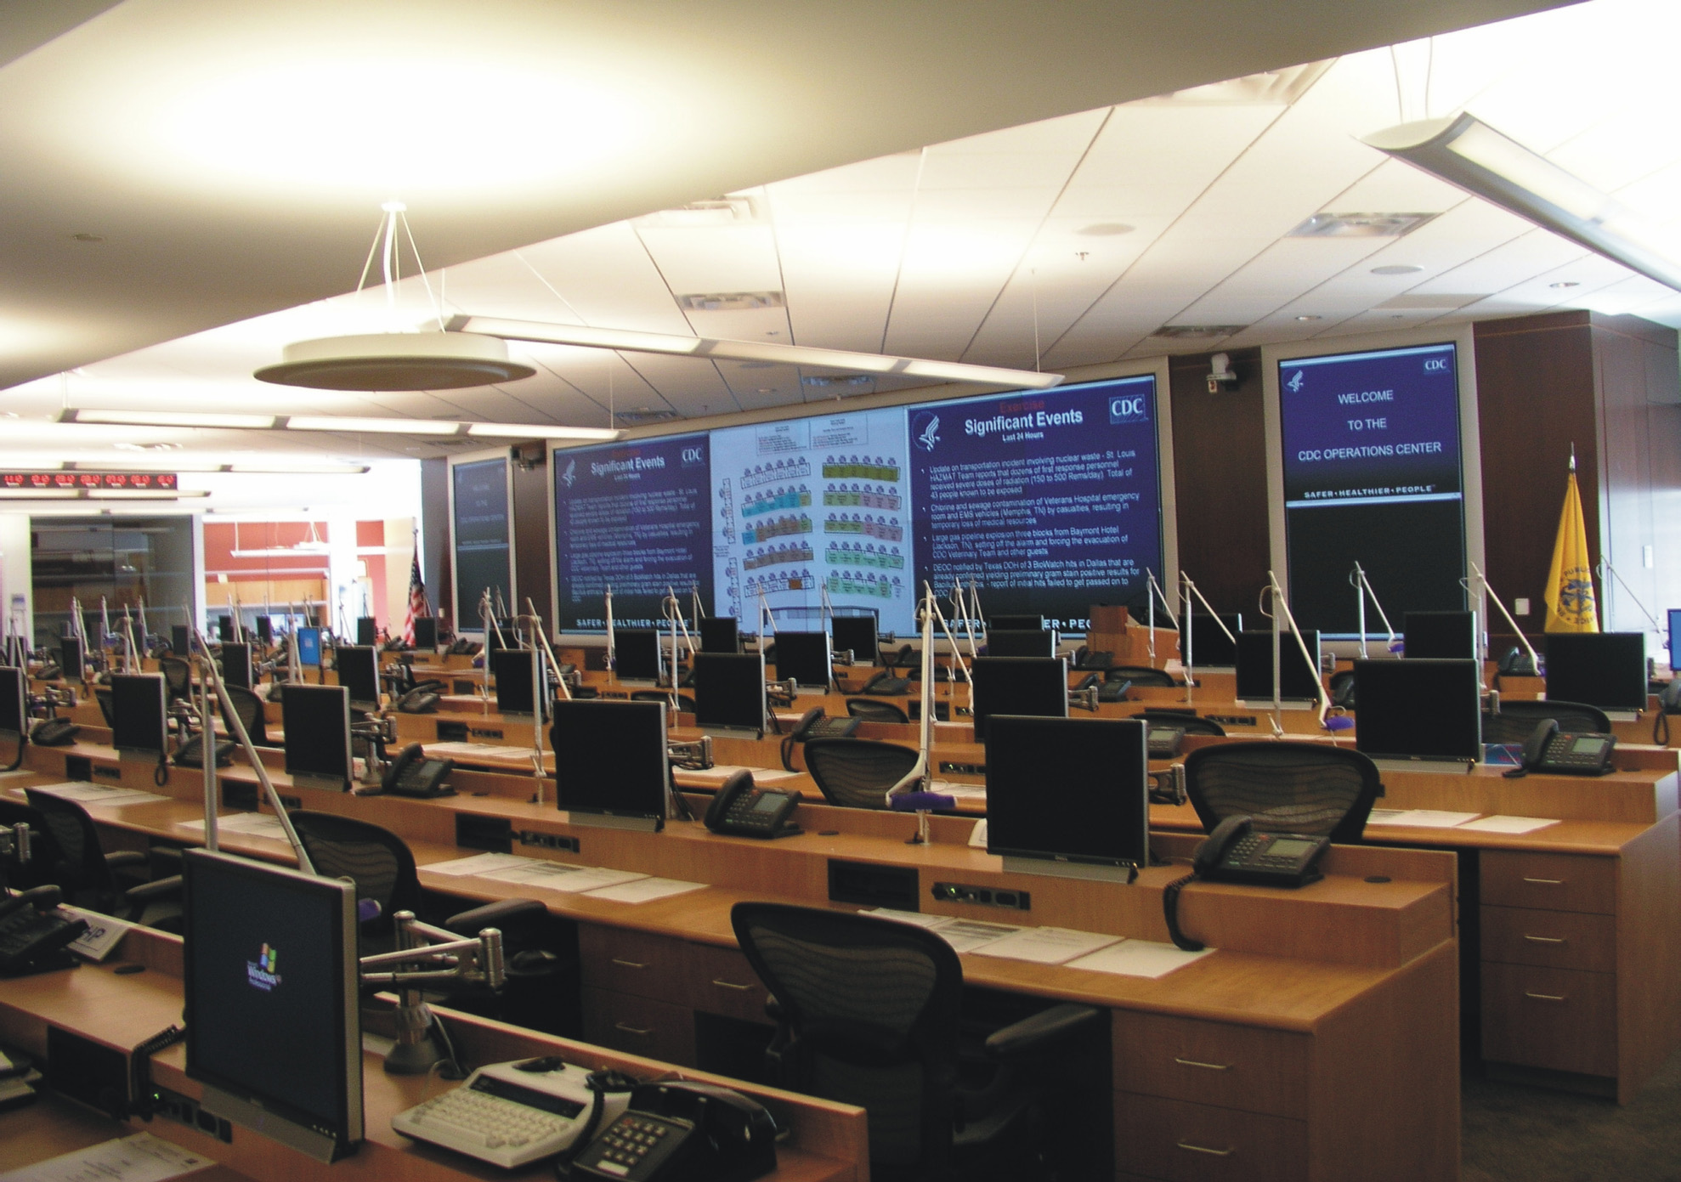
CDC EOC 21

Slide 7
Design Considerations
Executive office space
Staff seating
Computers, phones, printers, fax machines
Break-out or meeting rooms for teams
Special use rooms: Press room, communications
Hygiene space
Sleeping quarters
Food service and eating space
Environment: Noise level, air quality

Slide 8
EOC Location
What factors did your jurisdiction consider when selecting a facility for its EOC?
Accessibility
Safety
Size
Systems capability
Survivability
Versatility
Unit 6: Designing the EOC

Slide 9
Boardroom
Unit 6: Designing the EOC

Slide 10
Mission Control
Unit 6: Designing the EOC

Slide 11
MarketPlace

Slide 12




Bulls-Eye

Slide 13
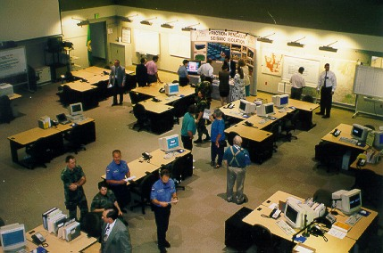
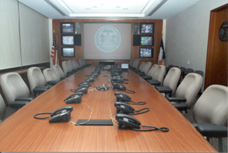
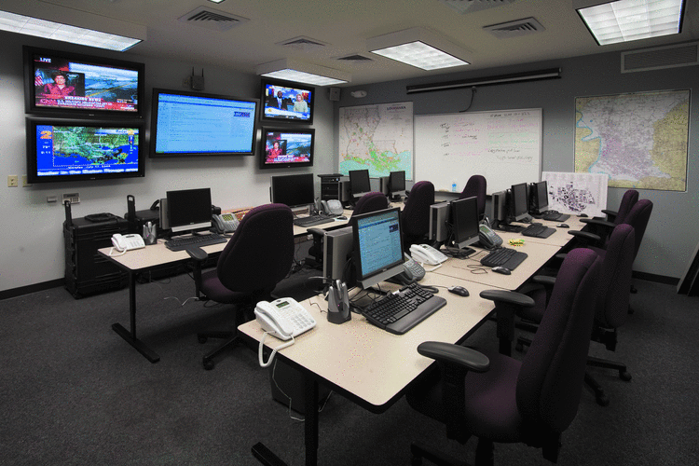
Lay-Outs

Slide 14
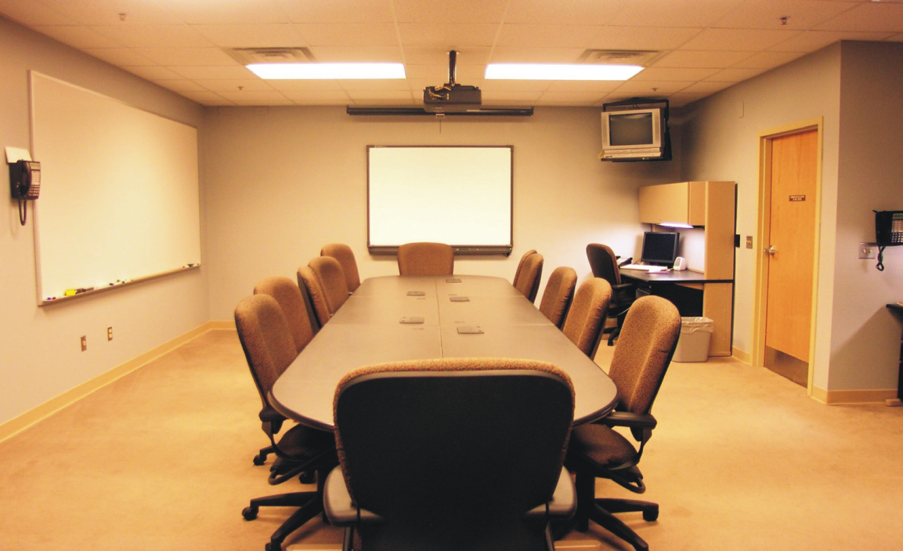
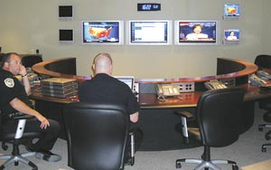
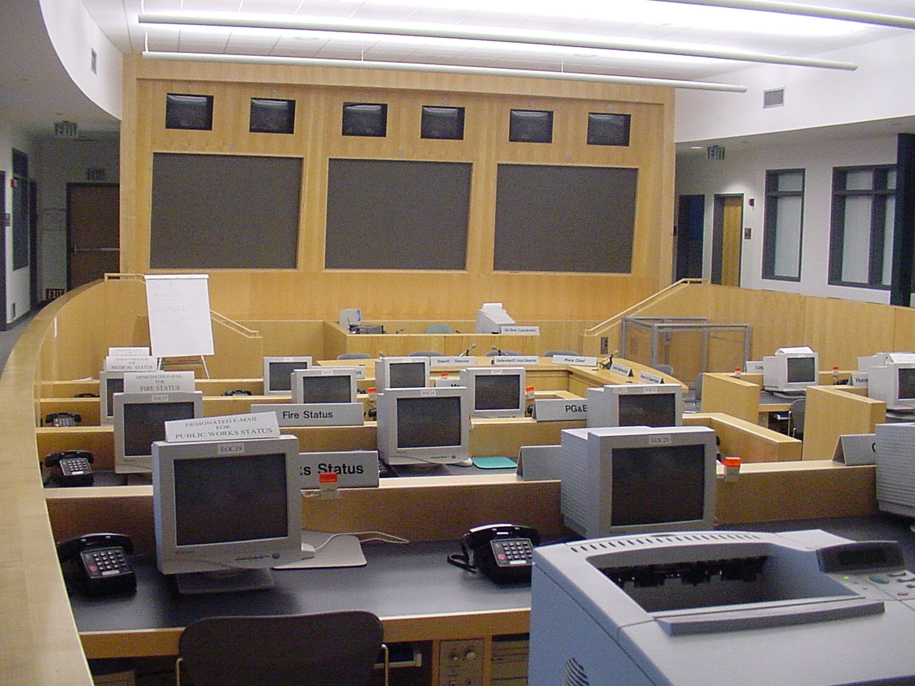
Lay-Outs

Slide 15
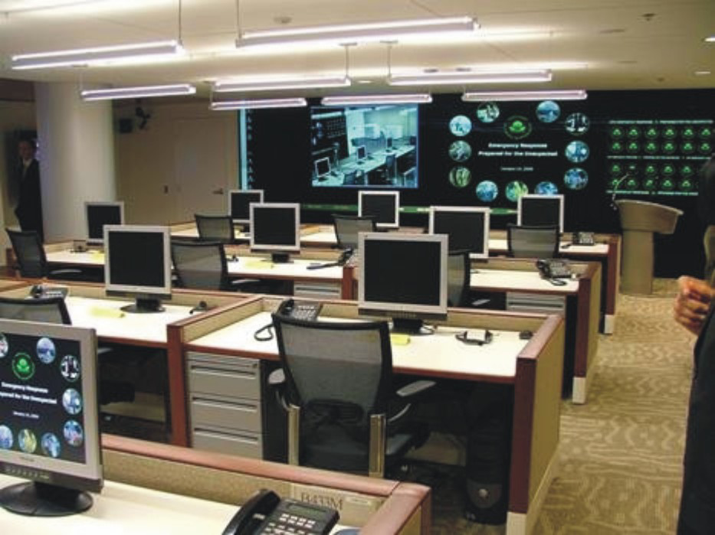
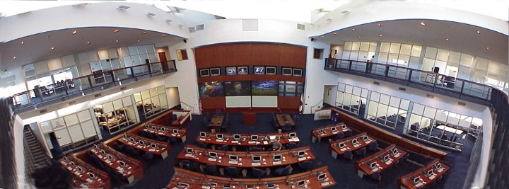
Hybrid

Slide 16
Equipment
The equipment in an EOC should:
Reflect the scope and design of the facility
Be sufficient to support the EOC’s functions
Be optimized for long-term sustainability
Personnel in the EOC must be trained in the use of equipment as part of their on-boarding as well as through regular refresher training.

Slide 17
Hot, Warm, and Cold Facilities
Hot: Fully equipped, utilities working, shortest startup period required.
Highest Cost
Warm: Some systems/equipment in place, moderate startup period required.
Lowest Cost
Cold: Not equipped, utilities not working, longest startup period required.

